Slide 1
Digital marketing Project on Techmahindra

Slide 2

Students & Mentor details
TEAM DETAILS :
Team ID: LTVIP2024TMID15005
1. SAVARA. JEEVANA RAO (TEAM LEADER)
2. BATTINI. SRINIVASA RAO(Team member)
TEAM MENTOR :
3. KORNANA DHARMARAO (TELUGU LECTURER)
UNIVERSITY NAME : Dr. B.r.Ambedhkar University
Etcherla Srikakulam

Slide 3


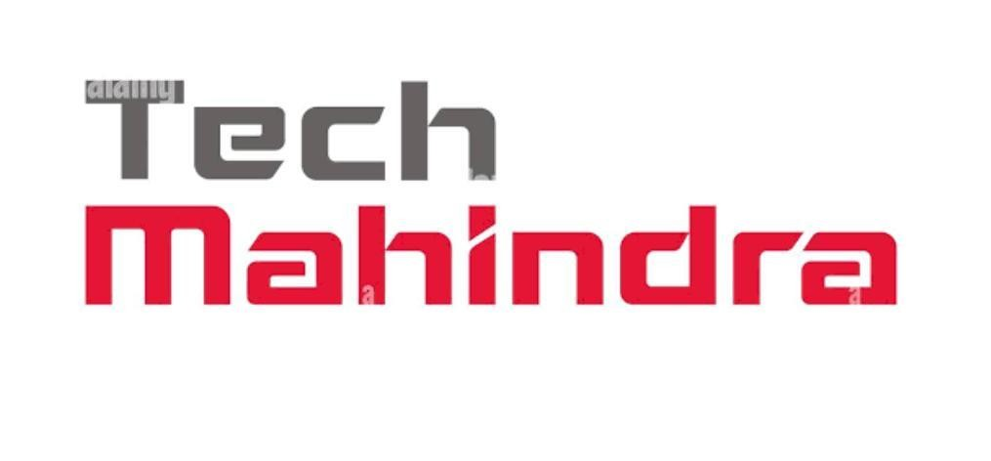
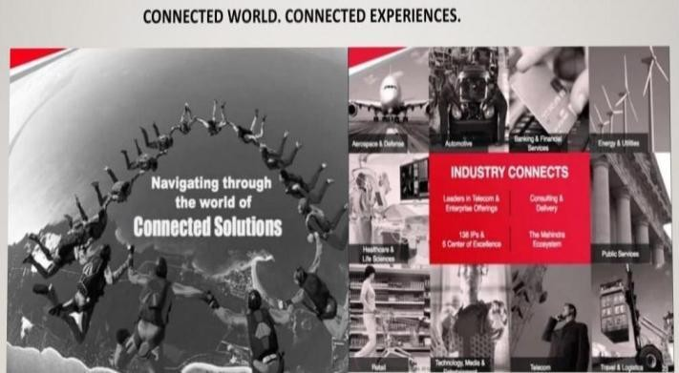
Brand:Tech Mahindra
Brand logo:
Brand Tagline:

Slide 4
Part 1:Brand study, competitor Analysis ,Buyer’s , Audience’s Persona:
Brand study( Mission /values &USP)
Mission &values: Tech Mahindra’s core mission is cantered around driving digital transformation and fostering innovation for businesses across various industries.
Customer First: Tech Mahindra puts the customer at the centre of everything they do, striving to exceed expectations and deliver exceptional service.
Integrity: Tech Mahindra operates with the highest ethical standards, promoting transparency, honesty, and accountability in all business dealings.

Slide 5
Teamwork: Collaboration and teamwork are key to Tech Mahindra’s success, fostering a culture of inclusivity, respect, and support.
Professionalism: Tech Mahindra values professionalism in all aspects of their work, from communication to quality of service, ensuring that they deliver the best possible results.
Social Responsibility: Tech Mahindra is committed to making a positive impact on society, promoting sustainability, diversity, and community engagement.
USP:Leading IT solution provider in the telecom vertical.

Slide 6
Brand study(Brand Tone&KPI)
Brand Tone: We are an enterprise driven by our promise to deliver Connected Experiences for the Connected World. We thrive on Change to create a better future for our customers, partners, associates, and stakeholders.
Tech Mahindra KPIs Include:
Revenue Growth: Tracking the growth in revenue over time is a fundamental KPI for any business. This could be broken down further into revenue growth from existing clients versus new clients.
Client Satisfaction: Measuring client satisfaction through surveys, feedback, and client retention rates is crucial for service-oriented companies like Tech Mahindra.

Slide 7
Project Delivery Timeliness: Ensuring that projects are delivered on time and within budget is critical. KPIs related to project timelines, milestones achieved, and adherence to budgets are important.
Employee Utilization: Tracking how effectively employees are utilized on projects helps in optimizing resource allocation and improving productivity.

Slide 8
Buyer’s /Audience’s Persona:
Tech Mahindra caters to a diverse range of buyers, primarily focusing on businesses and organizations rather than individual consumers. Their audience personas typically include:
Enterprises and Corporations: Tech Mahindra serves large enterprises and corporations across various industries such as telecommunications, healthcare, banking, retail, and manufacturing. Their buyers within these organizations are often C-suite executives, IT directors, and department heads who are looking for digital transformation solutions, IT services, consulting, and outsourcing.
Telecommunication Companies: Given its strong roots in the telecommunications sector, Tech Mahindra targets telecom companies looking for services like network transformation, managed services, 5G solutions, and customer experience management.

Slide 9
Healthcare Providers: Tech Mahindra offers healthcare solutions including digital health platforms, telemedicine, electronic health records (EHR), and data analytics. Their buyers in this sector include hospital administrators, IT managers, and healthcare executives.
Financial Services Institutions: Financial institutions such as banks and insurance companies are another key audience for Tech Mahindra. They offer services like core banking solutions, fintech solutions, cybersecurity, and regulatory compliance services to this sector.
Retail and Manufacturing Companies: Tech Mahindra provides digital solutions for retail and manufacturing businesses, including supply chain management, customer experience solutions, IoT integration, and automation services. Their buyers in these sectors are often operations managers, supply chain executives, and digital transformation leads.

Slide 10
Competitor Analysis :
Competitor 1: Wipro
USP: Global Presence: Wipro has a strong global presence with operations in over 175 cities across six continents. This extensive reach allows them to serve clients worldwide and provide localized solutions and support.
Online Communication:
Website: Wipro’s website serves as a central hub for information about their services, solutions, industry expertise, case studies, news, and career opportunities. It also provides access to client portals and resources.
Social Media: Wipro maintains active profiles on major social media platforms such as LinkedIn, Twitter, Facebook, and YouTube.

Slide 11
3.Email Marketing: Wipro utilizes email marketing campaigns to reach out to clients, prospects, and subscribers with targeted content, product/service offerings, event invitations, and industry insights.
Webinars and Virtual Events: Wipro conducts webinars, virtual events, and online workshops to showcase their expertise, discuss industry trends, and engage with clients and prospects in a virtual environment.
Content Marketing: Wipro publishes blogs, whitepapers, case studies, infographics, and videos as part of their content marketing strategy. These resources provide valuable insights, showcase their capabilities, and help educate their audience.

Slide 12
SWOT Analysis :
Strengths :Diverse Service Offerings: Wipro provides a wide range of IT services, including software development, consulting, business process outsourcing, digital transformation, and cloud services, making it adaptable to diverse client needs.
Weaknesses :Competitive Pressure: The IT services industry is highly competitive, and Wipro faces competition from other major players such as Tata Consultancy Services (TCS), Infosys, and global firms like IBM and Accenture.
Opportunities: Digital Transformation: The growing demand for digital transformation services presents significant opportunities for Wipro.

Slide 13
Threats :Data Security and Privacy Concerns: Data breaches and privacy issues could affect Wipro’s reputation and lead to legal consequences.
Competitor 2:Tata Consultancy Services(TCS)
USP: TCS has a strong global presence with operations in numerous countries, allowing it to offer services on a worldwide scale.
Online Communication:
TCS uses various digital platforms and tools for internal collaboration, client communication, and project management. This includes video conferencing platforms like Zoom and Microsoft Teams, collaboration tools like Slack and Microsoft SharePoint, and project management tools like Jira and Trello. TCS also utilizes email, instant messaging, and social media for communication and outreach purposes.

Slide 14
SWOT Analysis :
Strengths : Strong Brand Reputation: TCS is well-regarded in the IT industry, known for its quality services and a history of successful client partnerships.
Weaknesses: Over-Reliance on Specific Sectors: TCS may face overreliance on specific industries, such as financial services for TCS, making them vulnerable to industry-specific economic downturns.
Opportunities: Emerging Technologies: TCS can capitalize on emerging technologies like IoT, 5G, Al, and automation to improve its service offerings and efficiency.
Threats: Data Security and Privacy Concerns: Data breaches and privacy issues could affect the reputation of TCS and lead to legal consequences.

Slide 15
Competitor 3:Infosys
USP: It has a strong global presence and provides a wide range of services including software development, system integration, consulting, and outsourcing.
Online communication some potential distinctive online. Communication some potential distinctive online communication practices used by Infosys are Infosys Knowledge Institute, Infytv, Infychat, Investor Relations Portal.
SWOT Analysis :
Strengths: Strong Brand Reputation: Infosys is well-regarded in the IT industry and is known for its quality services, a history of successful client partnerships, and a commitment to innovation.
Weaknesses: Over-Reliance on North America: A significant portion of Infosys’s revenue comes from North America, making it vulnerable to economic downturns or changes in regulations in that region.

Slide 16
Opportunities: Block chain and lot : Infosys can capitalize on the growth of block chain technology and the Internet of Things (IoT) in various industries. Strategic Partnerships: Collaborating with technology companies, startups, and academic institutions can lead to innovative solutions and access to new markets.
Threats: Regulatory Changes: Changes in data protection and
immigration regulations can impact Infosys’s operations and workforce.

Slide 17
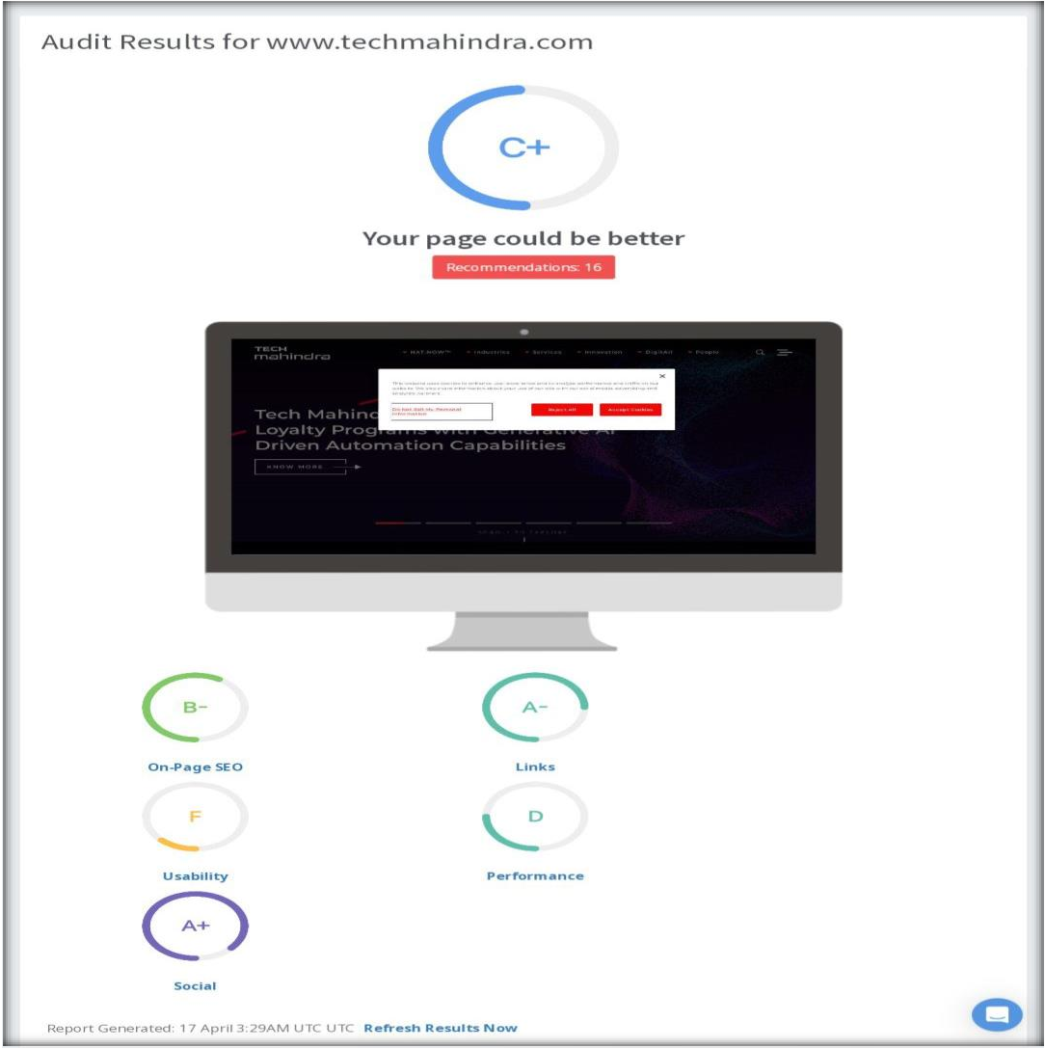
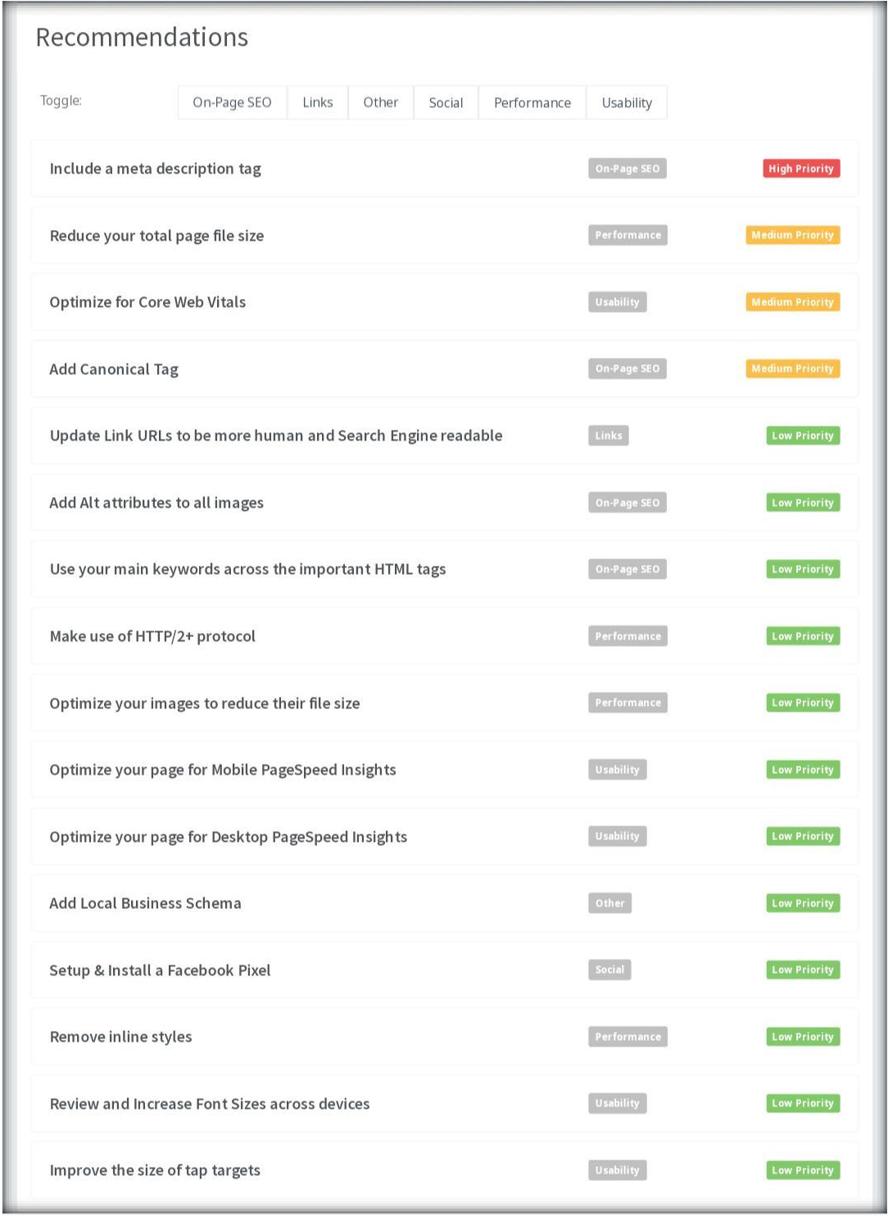
Part 2: SEO & Keyword Research
SEO Audit :

Slide 18
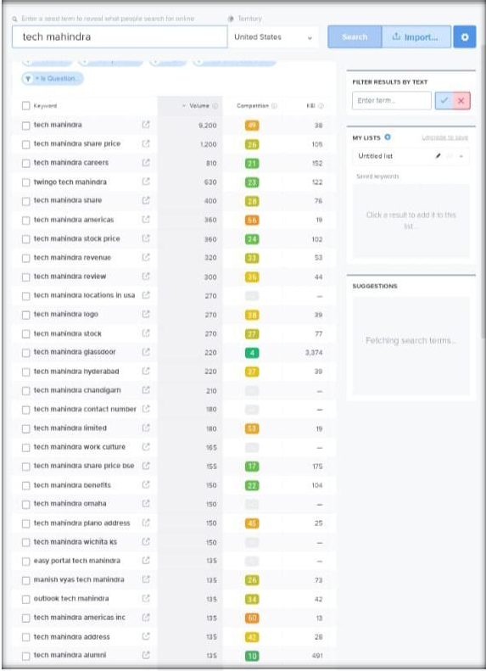
Keyword Research
Primary keywords:
Tech Mahindra share price
Tech Mahindra careers
Twingo Tech Mahindra
Tech Mahindra Share
We can use these 4 as primary keywords since they have decent volumes and are relevant to Brands.

Slide 19
On Page Optimization
Focus keywords :Tech Mahindra share price, Tech Mahindra careers, Twingo Tech Mahindra, Tech Mahindra share.
Meta Title:Tech Mahindra/Connected world, connected Experiences.
Meta Description : Tech Mahindra represents the connected world, offering innovation&human-centric technology experiences to our customers, stakeholders.

Slide 20
Content Optimization Introduction: In the dynamic landscape of the stock market, Tech Mahindra has emerged as a prominent player, captivating investors’
attention with its innovative solutions and robust performance. In this article, we delve into the intricacies of Tech Mahindra’s share price, analyzing its past trends, current factors influencing its valuation, and providing an outlook for the future.
Industry Trends: The IT and technology sector’s performance directly impacts Tech Mahindra’s share price. Changes in technology adoption, digital transformation trends, and industry disruptions can influence investor sentiment.
Financial Performance: Tech Mahindra’s quarterly and annual financial results, including revenue growth, profitability, and margins, play a crucial role in determining its share price. Positive financial indicators often lead to bullish investor sentiment.

Slide 21
Market sentiment : External factors such as global economic conditions, geopolitical events, and market sentiment can impact Tech Mahindra’s share price. Investor perception and market sentiment can drive short-term fluctuations.
Competitive Landscape: Tech Mahindra’s competitive position within the IT services industry, market share, client acquisitions, and strategic partnerships can influence investor confidence and long-term growth prospects.
Conclusion:Tech Mahindra’s share price journey reflects its resilience, innovation, and strategic vision in navigating the complexities of the market. As the company continues to expand its capabilities and capitalize on emerging opportunities, investors remain optimistic about its growth trajectory. Understanding the factors driving Tech Mahindra’s share price is essential for informed investment decisions in the dynamic world of finance.

Slide 22
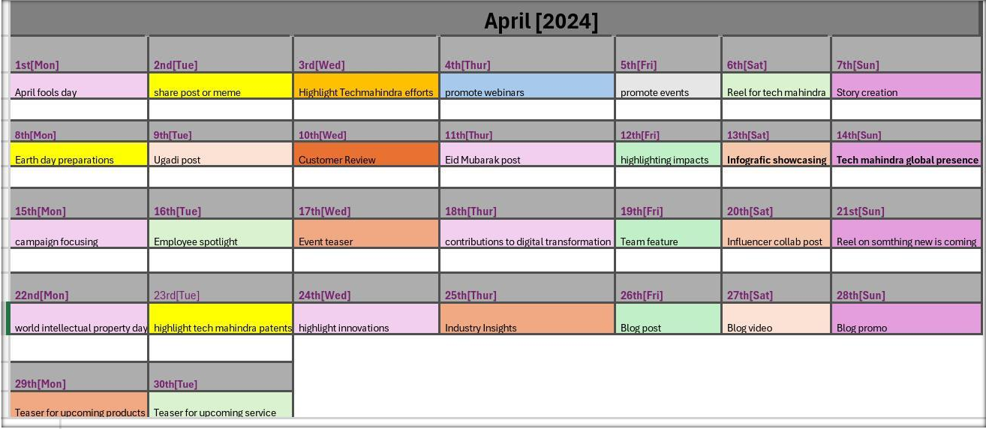
Part 3: Content Ideas and Marketing Strategies

Slide 23
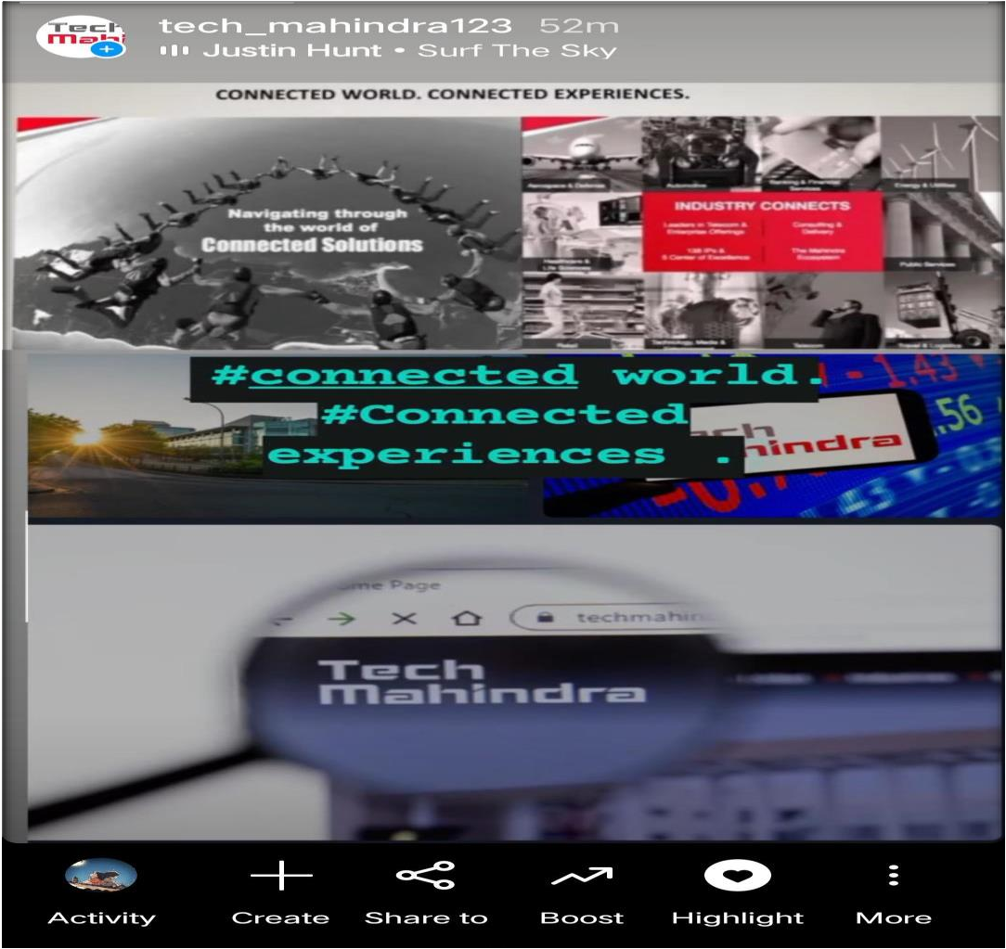
Strategy, Aim and the Idea behind this story:
The strategy behind this “Ǫ&A”
Strategy is to educate followers about the importance of Tech Mahindra, IT Solutions.

Slide 24
Part 3: Content Ideas and marketing strategies
Content Ideas:
Industry Insights: Create content that provides insights into emerging trends, challenges, and opportunities in the IT and technology sector.
Case Studies: Showcase Tech Mahindra’s successful projects and
collaborations with clients through detailed case studies.
Training and Development: Create content related to training programs, certifications, and skill development initiatives offered by Tech Mahindra. Educate the audience about career opportunities, professional growth, and industry-relevant skills.

Slide 25
Marketing Strategies:
Digital Marketing: Leverage digital channels such as social media, email marketing, content marketing, and search engine optimization (SEO) to reach and engage with target audiences.
Thought Leadership Platforms: Participate in industry events, webinars, conferences, and panel discussions to establish Tech Mahindra as a thought leader.
Customer Advocacy: Cultivate strong relationships with existing clients and turn them into brand advocates. Encourage satisfied customers to share testimonials, case studies, and success stories to build trust and credibility among prospects.

Slide 26
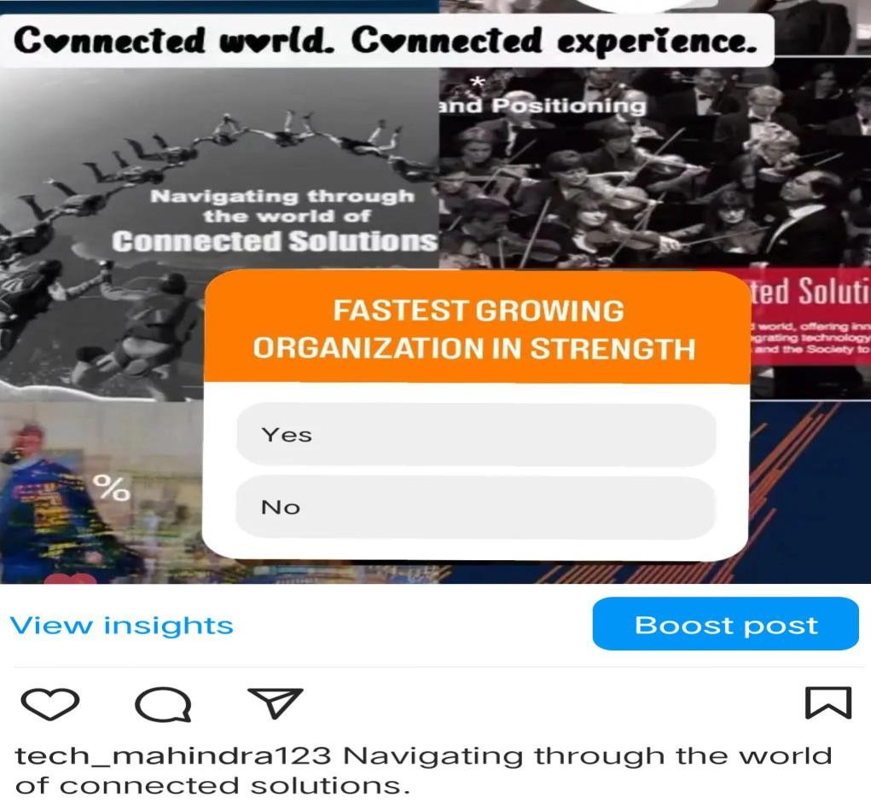
Part 4: Content creation and curation
Format 1: Static post on Tech Mahindra
Caption: Navigating through the world of connected solutions.
Hashtags: #connected world. #connected experiences.

Slide 27
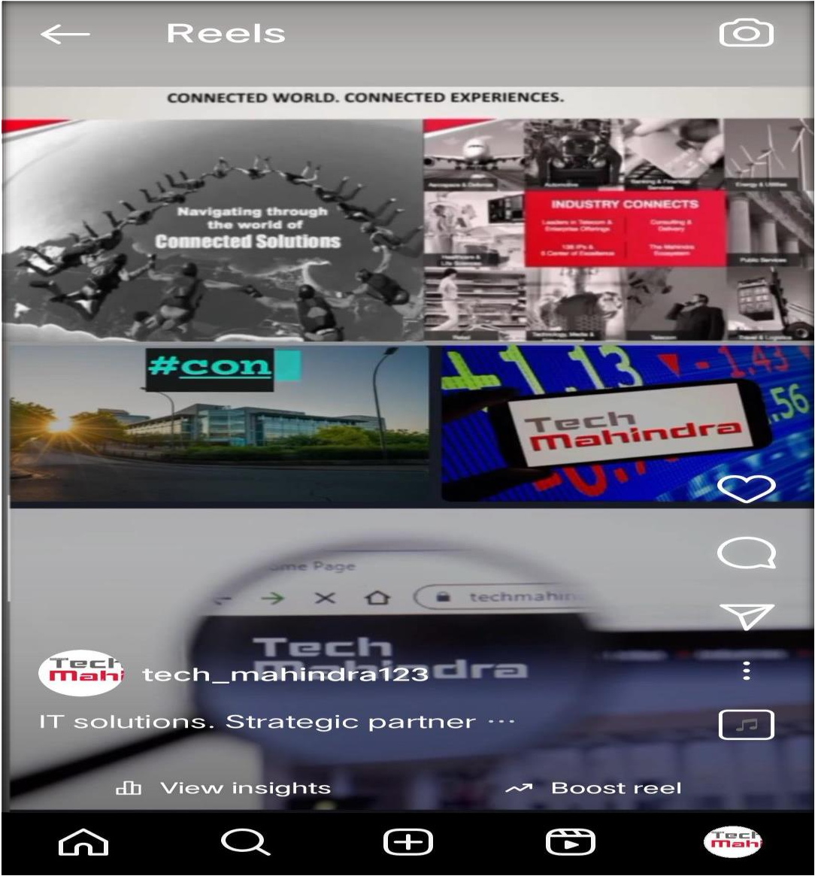
Format 2: Reel post on Tech Mahindra Caption: IT Solutions. Strategic partner.
HashTags: #connected world. #connected experiences.

Slide 28

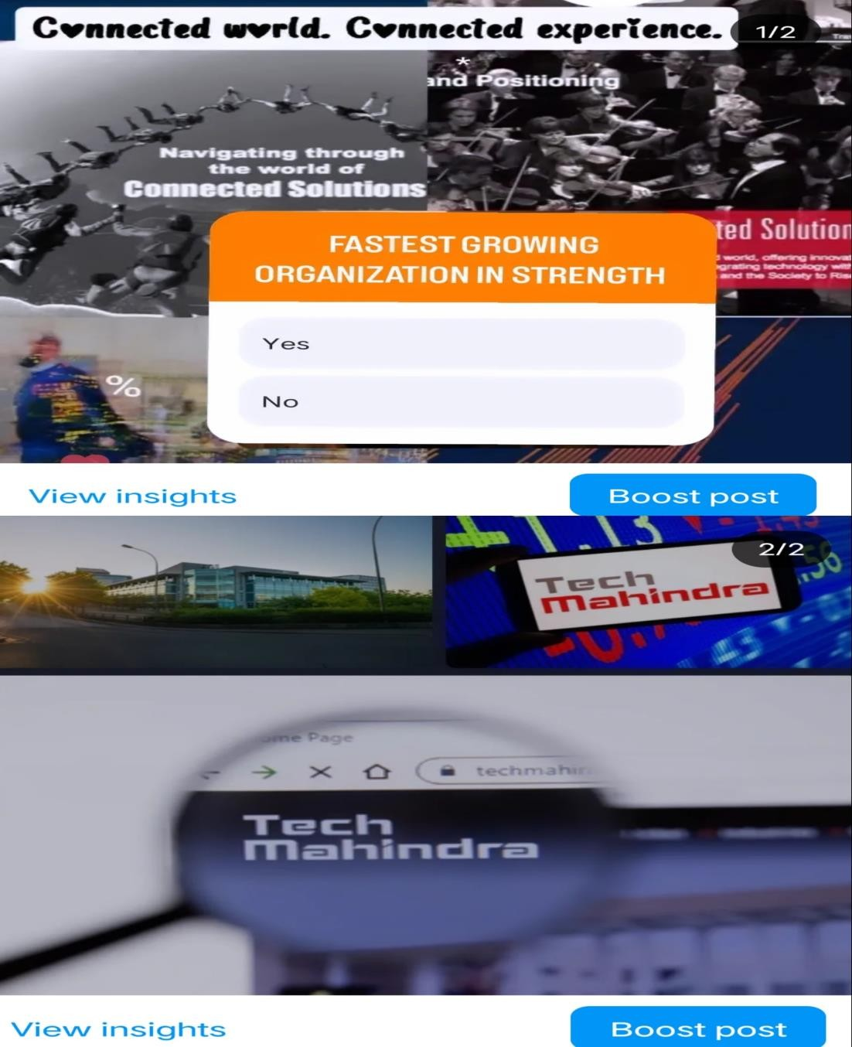
Format 3: coursel post on Tech Mahindra Caption: IT solutions. Strategic partner. Hashtags :#IT solutions.

Slide 29
Part 4: Content creation and curation
Instagram Story Instagram Account link:
https://www.instagram.com/invites/contact/?i=1pd1rky9yg ads&utm_content=sfqqj3k
Story link:
https://www.instagram.com/stories/tech_mahindra123/334 8688093031930806?utm_source=ig_story_item_share&igs h=ZDY3azFxbGpybXdj

Slide 30


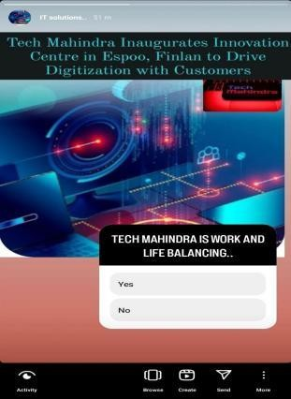
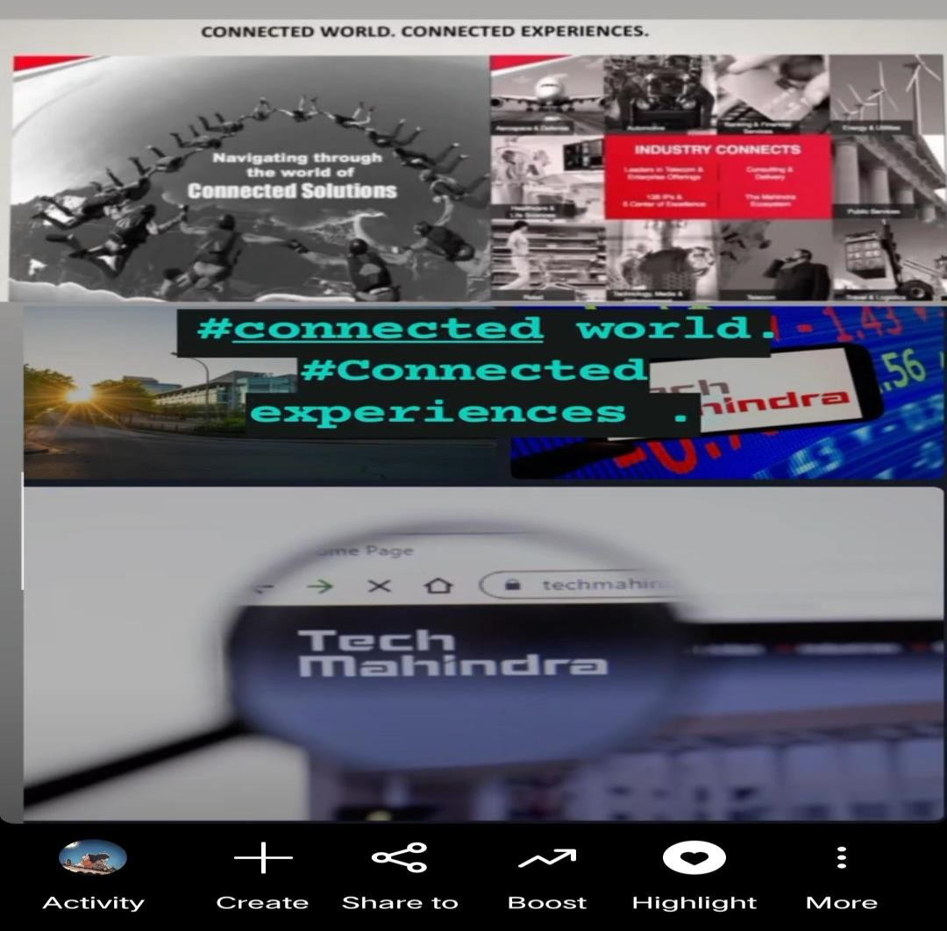
Screenshots of Story:

Slide 31
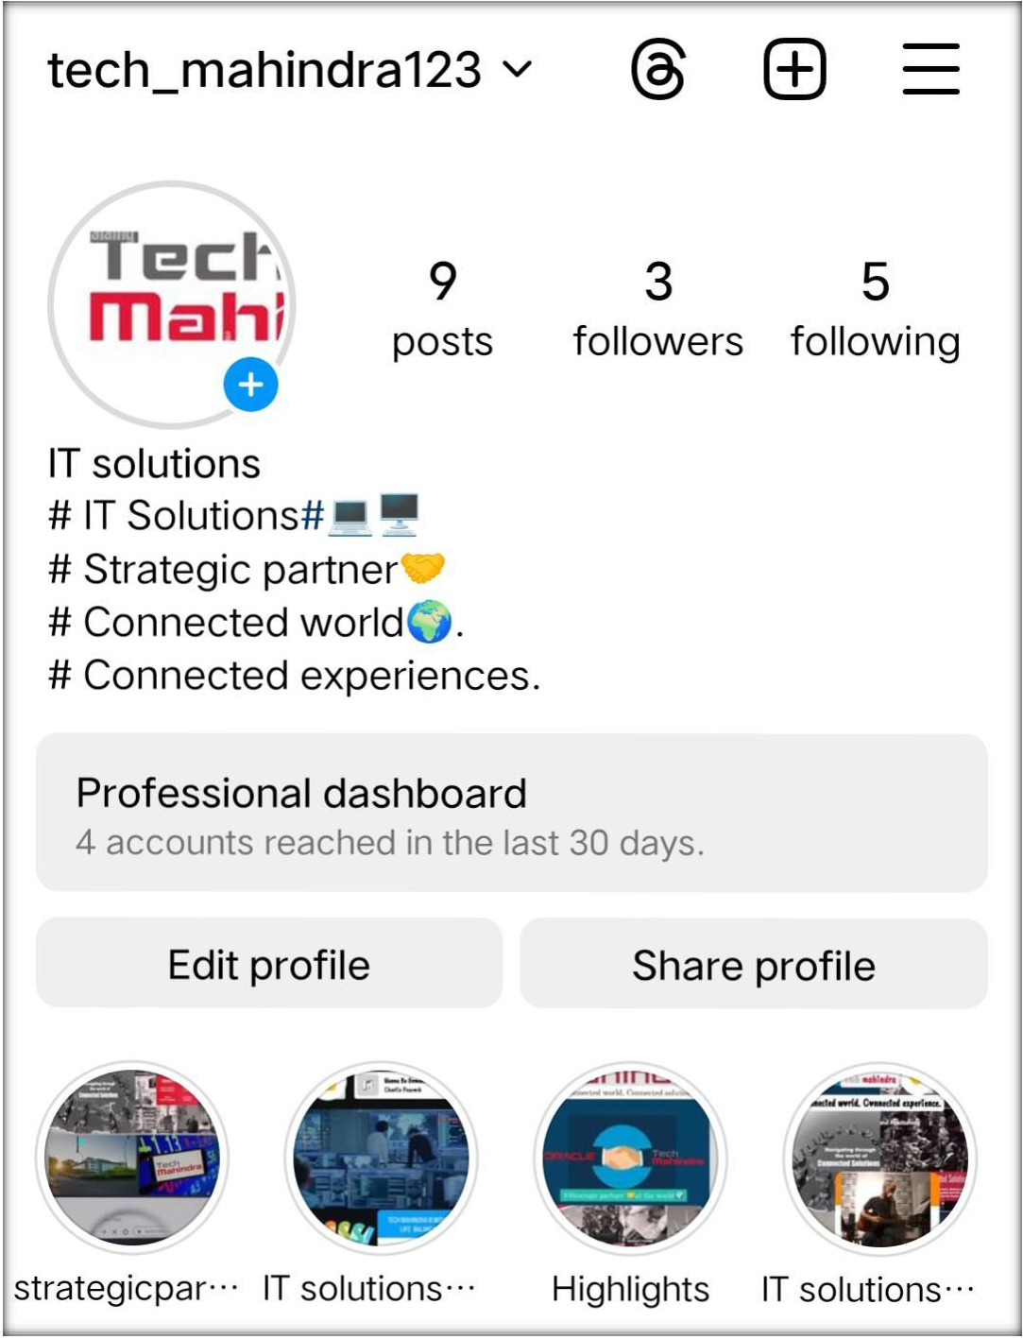
Highlights of Story:
Instagram Account link:
https://www.instagram.com/invites/ contact/?i=1pd1rky9ygads&utm_con tent=sfqqj3k

Slide 32

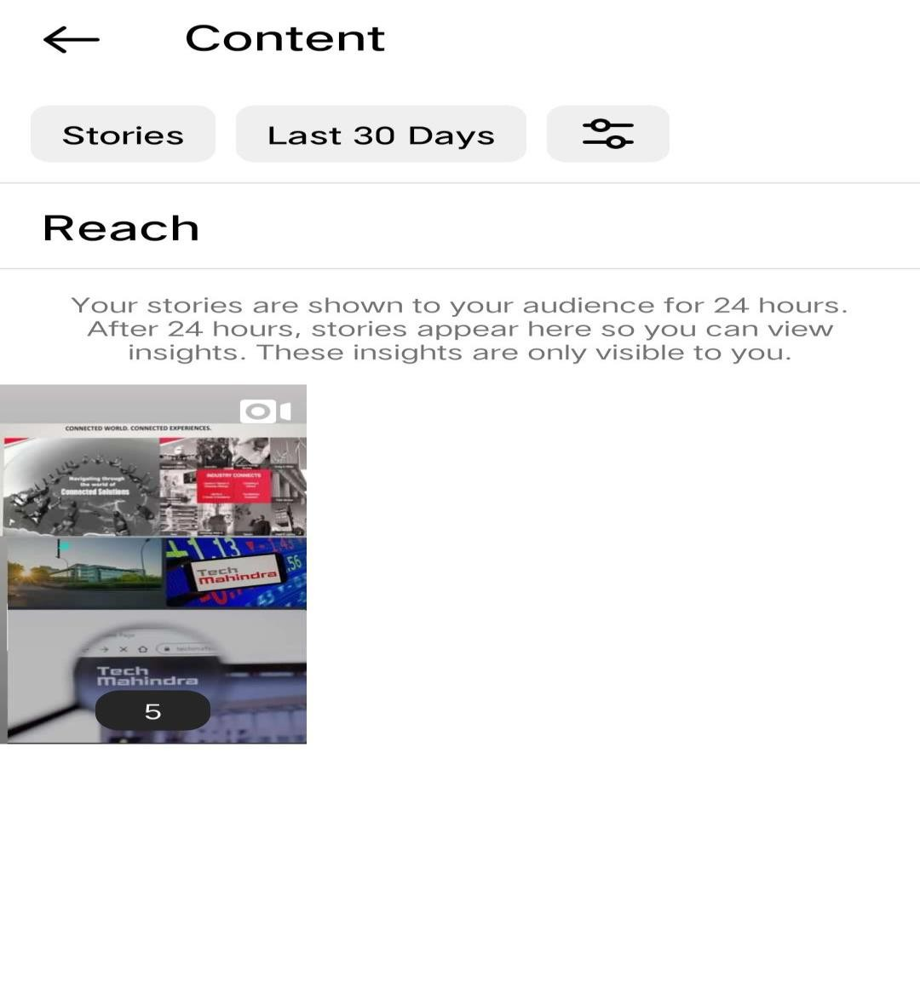
Story Insights – Q&A
Reach is 5
Impressions is 22
Likes is 6
Comments is 2
Content interactions is12 Area for Improvement:
Story could be better. Poll option would help in getting engagement.
Since the shares of informative stories are more, we could create more informative stories

Slide 33
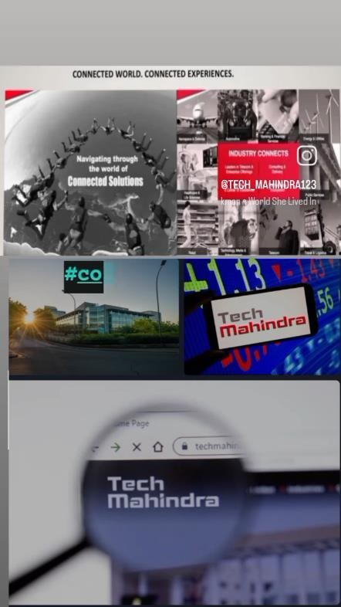
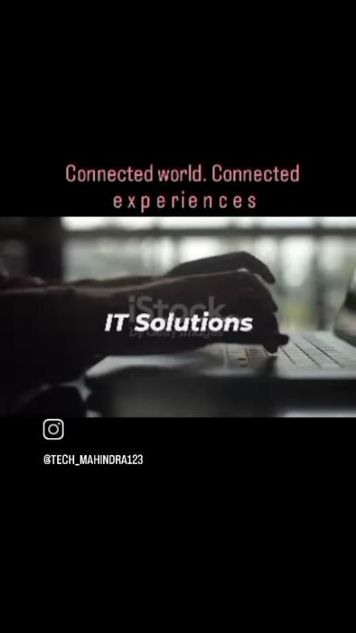
Designs /Video Editing

Slide 34
Thank you!!
Team ID: LTVIP2024TMID15005
Team leader name: SAVARA JEEVANA RAO

